Slide 1
Building Evaluation with Logic Models
Derek Meyers & Ryan Smith
Includes ideas from Diane Garder, College of Education, and Erin Thomas, Student Affairs
University Assessment Services
April 3, 2018
Center for Teaching, Learning & Technology Resource Commons

Slide 2
Today
Build a logic model.
Explain the elements of a logic model.
Describe the benefits of using a logic model for planning and program assessment.

Slide 3
What is a Model?
Curricular Goals
ASSESS
Collecting evidence of students’ status
Assignments, projects, demonstrations, etc.
INFER
Making evidence-based interpretations about what you think students might know (covert)
Parts of the curriculum are or are not changed
Instructional*
Instruction is or is not changed*
*This is based on a K-12 model. Changes in instruction are generally left up to the instructor in higher education. It is strongly recommended that assessment of student learning and program evaluation decisions and processes be separate from instructional evaluation in higher education.
J. Popham, 2010, Everything School Leaders Need to Know About Assessment, Corwyn.

Slide 4
What is a Model?
Environment
Outcome / Impact
Inputs
A. Astin, 1991, Assessment for Excellence, Oryx.

Slide 5
What is a Model?
Before Learning Event
Learning Event
After Learning Event
Discuss project goals
Student expectations
Assignment criteria
Ability to do something
Knowing something
Valuing something
Projects
Classroom or studio experiences
Co-curricular activities
Model from S. Gill, 2007, Developing a Learning Culture in Nonprofit Organizations, Sage.

Slide 6
Logic Model
Inputs, Resources
Activities, Curriculum, Program
Program completers (outputs)
Short and long-term impact
If you have access to…
If you provide…
If you have…
Then you
can deliver…
Then you
will have…
Then you
will have…
Notes:
Graphic representation of how a program works and/or
How students change

Slide 7
Why Use a Logic Model
Provides a simplified picture of relationships between activities, goals, and outcomes.
Makes connections and underlying assumptions explicit.
Summarizes complex processes.
Helps show where evaluation results and ideas can be implemented.
Describes how a program works and how students change.

Slide 8
Issue: Students keep breaking laundry machines
If you have access to resources & inputs, then you can implement activities
If you implement activities, then a quantity will be produced
If those benefits are achieved, then changes in participants will occur
If a quantity is produced, then participants will benefit in some way
Available resources & inputs
RA s post how to guides
Laundry usage info incl. in orientation
RA s, staff, paper, ‘how to’ guides, printing budget
Decrease in broken washing machines & repairs
College saves time & $
Students learn how to do laundry
Help create responsible adults
1
2
3
4
5
Logic Model by Shelbi Rushing, Illinois Wesleyan
Planned Work
Intended Results

Slide 9
Issue: Infection rates in hospitals
Inputs: Staff, time, materials, knowledge, research
Activities: Health care delivered to patients
Outputs: # of patients
Outcome/ Impact: Healthy patients
People surviving procedures
Lower infections
If you have access to…
If you provide…
If you have…
Then you
can deliver…
Then you
will have…
Then you
will have…
Notes:
Good theory, bad implementation / Bad theory, good implementation
Think about education (higher) and how it is similar to health care
Underlying theory is that if health care is delivered to patients, they must be healthy
But what if patients aren’t healthy? Is it the theory that is bad? Or is it the implementation?
The theory is good, but it is not implemented well. A logic model reveals that all kinds of things can go wrong (that’s what the arrows are).
Orange arrow: staff aren’t trained well. They don’t have access to materials. They spend too much time on administration. (Break down between resources and delivery of health care, before it’s even delivered).
In this case, good theory, bad implementation. Used checklists

Slide 10
Issue: Student writing skills
Faculty, time, materials, knowledge, research
Early Writing Courses
Students who pass early writing coursework
Students proficient in organization, clarity, formatting, & style
Good writers
If you have access to…
If you provide…
If you have…
Then you
can deliver…
Then you
will have…
Then you
will have…
Notes:
Theory is that writing early in college (gen ed, seminar, etc.) will lead to better writing later on.
Arrow 1 – no resources to provide adequate writing training. Students come in with very low skills in writing.
Arrow 2 – maybe the courses are fine, but are haphazardly implemented.
Arrow 3 – maybe students are good writers, but the assessment instrument is wrong? Or the standards are wrong?

Slide 11
Issue: Student writing skills
Staff, time, materials, knowledge, research, budget, GA s, HS partnerships, writing center
Students who pass early writing coursework
Students who proficient in organization, clarity, formatting, & style
Early Writing Courses
If you have access to…
If you provide…
If you have…
Then you
can deliver…
Then you
will have…
Then you
will have…
Notes:
Good theory, bad implementation

Slide 12
Issue: Student writing skills
Staff, time, materials, knowledge, research, budget, GAs
Students who pass early writing coursework
Students who proficient in organization, clarity, formatting, & style
Early writing courses, writing labs, WID, common learning experiences, curricular pathways
If you have access to…
If you provide…
If you have…
Then you
can deliver…
Then you
will have…
Then you
will have…
Notes:
Good theory, bad implementation

Slide 13
Issue: Student writing skills
Staff, time, materials, knowledge, research, budget, GAs
Papers, artifacts, student work, portfolios
Students who proficient in organization, clarity, formatting, & style
Early Writing Courses
If you have access to…
If you provide…
If you have…
Then you
can deliver…
Then you
will have…
Then you
will have…
Notes:
Good theory, bad implementation

Slide 14
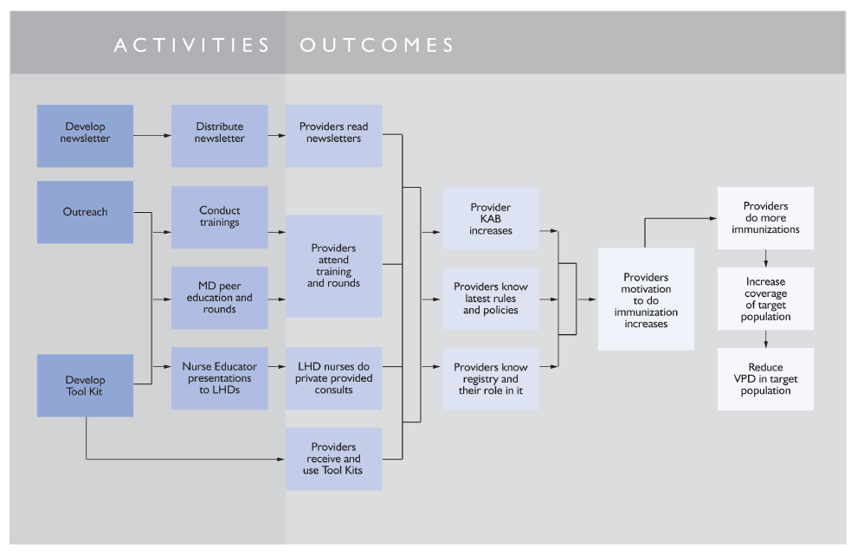

Slide 15
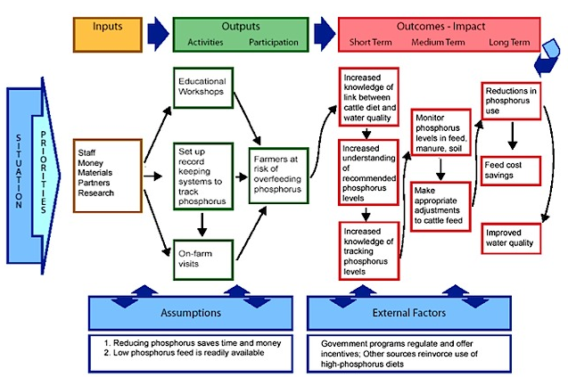

Slide 16
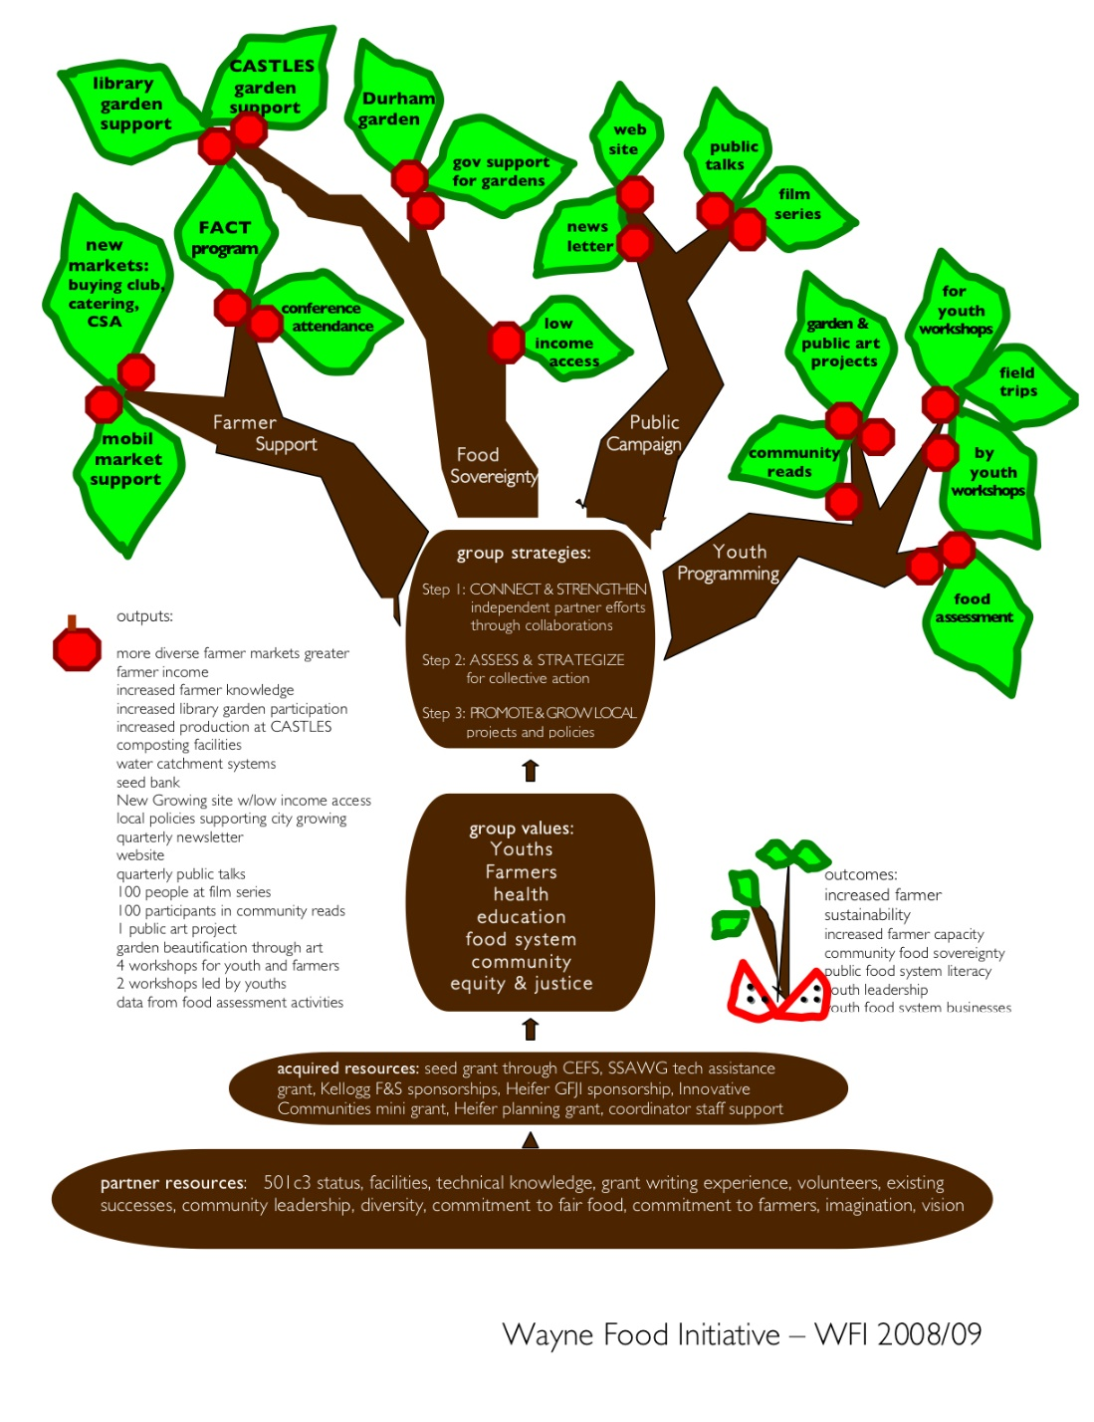

Slide 17
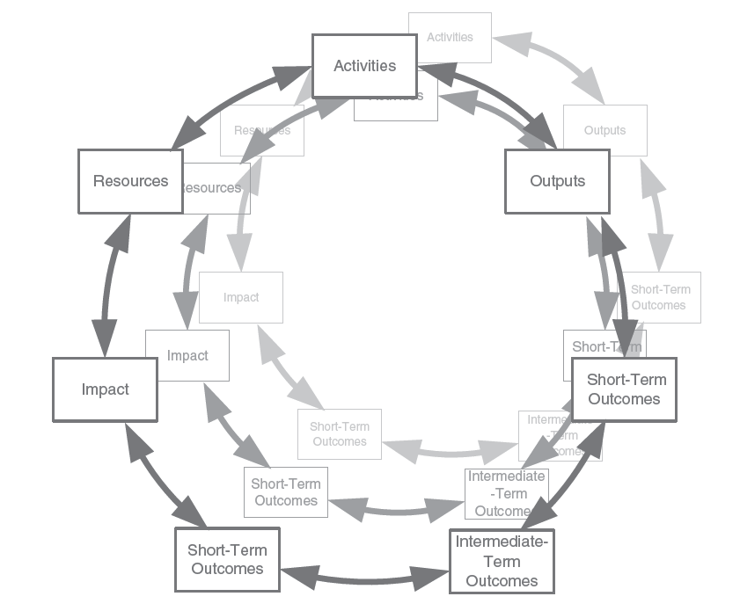

Slide 18
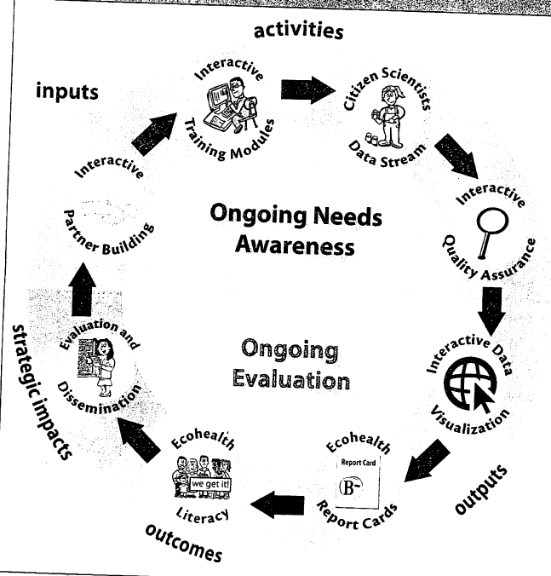

Slide 19
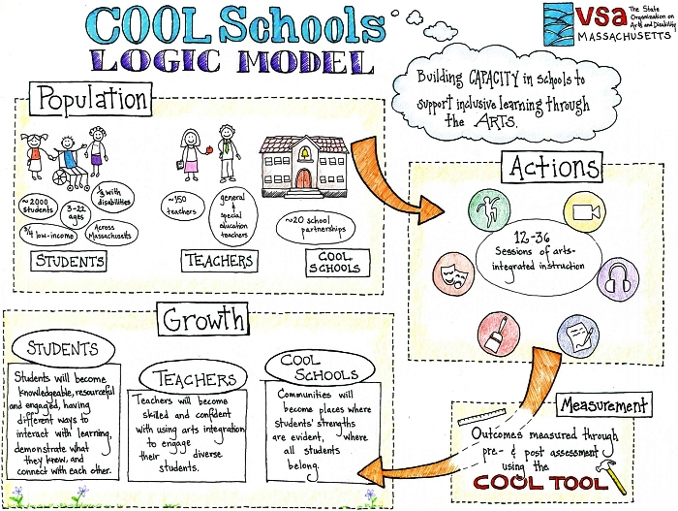

Slide 20
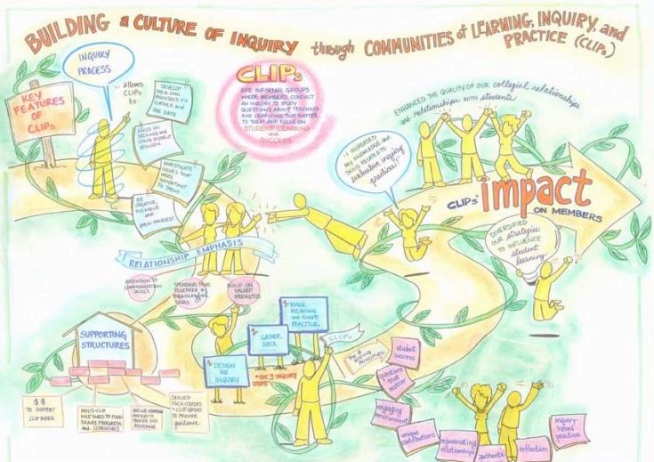

Slide 21
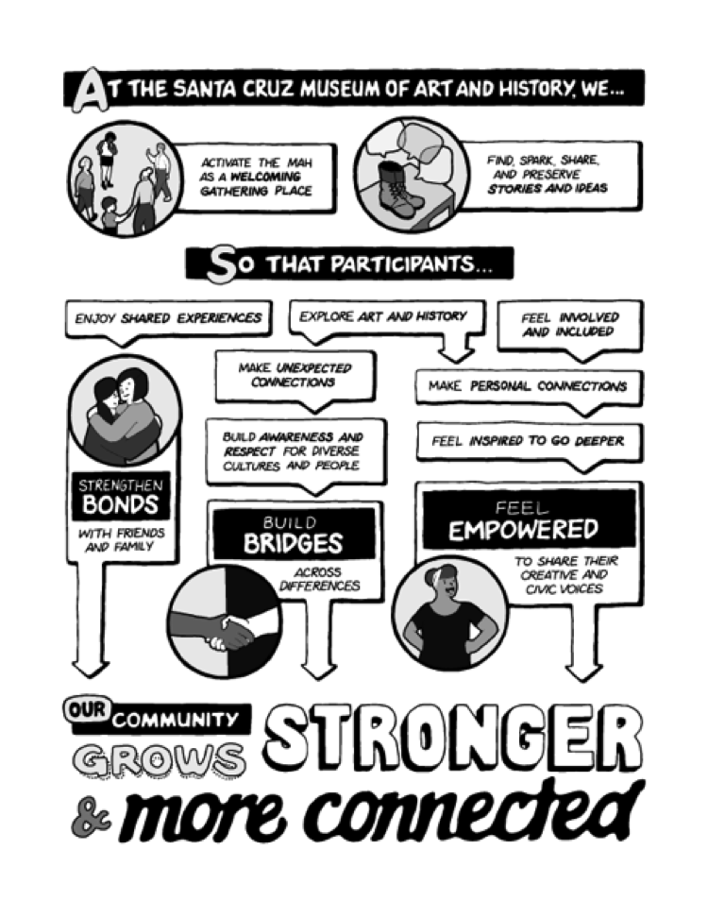

Slide 22
Key Ideas
Do not ignore unintended results.
Include stakeholders.
Just because you can build a logic model doesn’t mean the program is logical.
Do not treat the model as a simple, closed system.
Don’t just measure the building blocks – also focus on the relationships between them (the arrows).
Remember context and assumptions.
Making the model too linear.
Trying to fit too many outcomes in the model or being overly ambitious with long-term impact.
Not intended as an evaluation tool.
Notes:
Case about involving stakeholders. When Meals on Wheels (MW) switched to a private contractor, a program theory was developed, but only by the managers. They focused only on meal delivery and missed two components: social interaction with the clients and checking for hazards or accidents. Well-being was not even considered.
Conduct a needs analysis or situation analysis . A needs analysis identifies needs and problems. A situation analysis also acknowledges strengths and opportunities. A situation analysis identifies the nature and extent of the problems or opportunities to be addressed by the program. It describes various features of the problem. It also identifies known causes of or causal pathways to the problem and the known consequences of the problem (why the situation is problematic and worth addressing). For ex, preventative programs often treat the causes, while treatment programs treat the consequences. A situation is not a trigger event, although a trigger can lead to a program. For example, a construction accident can lead to safety awareness programs. This can lead to more opportunities to investigate and work on a problem.

Slide 23
Representation Ideas
Avoid dead ends.
Make sure the arrows are meaningful (‘the dash’).
Find a model representation that works for you.
Don’t make it too messy.
Avoid trigger words or acronyms.
Consider the pros and cons of different modes of representation (left to right, circular, etc.).

Slide 24
Limitations
Focus only on expected outcomes.
View programs as linear.
Programs usually don’t have total control over outcomes.

